Slide 1
An Introduction to PHP Framework Session 3
Course : COMP6681 – Web Programming
Effective Period : September 2021

Slide 2
Learning Outcomes
LO1: Describe concept of web programming
LO2: Design web-based applications with structured approach

Slide 3
Outline
Understanding Framework
Framework Vs PHP Native
MVC architecture
Introduction to Laravel
Installing Laravel
Accessing Laravel

Slide 4
Understanding Framework
A framework is a collection of ready-to-use program code with certain writing rules that aim to make it easier and faster to build applications. More specifically, the PHP framework is a framework created using the PHP programming language.
The main purpose of using a framework is to speed up application creation because in the framework there are various ready-to-use features. The user just uses this feature without the need to create everything from scratch. In addition, the writing rules in the framework will force us to use good writing methods (following best practice standards).

Slide 5
Understanding Framework
There are various frameworks for different purposes. For example, Bootstrap is a CSS framework that contains a collection of CSS code to speed up web design creation. Besides Bootstrap, there are many other CSS frameworks such as Materialize, Zurb Foundation, Bulma, and Semantic UI.
Likewise in PHP, there are various framework options such as Code Igniter, Symfony, Yii, Zend, and of course Laravel.

Slide 6
Framework Vs PHP Native
Using a framework will indeed shorten the application development time, but not all projects are suitable for using the framework.
The debate about whether to use a framework or not (that is, using the code "PHP only" or known as "PHP Native") has become an eternal debate in various discussion forums.

Slide 7
Framework Vs PHP Native
The reason it is better to use a framework :
Available features ready to use.
Following best practices.
Easy for collaboration.
Easy to read program code.
Application Security

Slide 8
Framework Vs PHP Native
The reason why you should not use a framework.
The application made is quite simple.
Do not have enough basic web programming.
Want to pursue performance.

Slide 9
Introduction to Laravel
Laravel is an open-source PHP framework, which is robust and easy to understand. It follows a model-view-controller design pattern. Laravel reuses the existing components of different frameworks which helps in creating a web application. The web application thus designed is more structured and pragmatic.
Laravel offers a rich set of functionalities that incorporates the basic features of PHP frameworks like CodeIgniter, Yii, and other programming languages like Ruby on Rails. Laravel has a very rich set of features that will boost the speed of web development.

Slide 10
Introduction to Laravel
The initial idea for making the Laravel framework came from a problem faced by Taylor Otwell in 2011. At that time there were actually quite a number of PHP frameworks available, one of the most popular being Code Igniter (often abbreviated as CI).
The CI framework is good enough, but Taylor feels it still doesn't suit his needs. One of the features that are not available in CI is the built-in user authentication and user authorization, which is a user registration and login mechanism. Even though almost all web applications need this feature.
So Taylor tried to design a PHP framework called Laravel. The choice of the name Laravel itself is also quite unique because it was inspired by the Cair Paravel castle from the novel/film The Chronicles of Narnia.

Slide 11
MVC architecture
MVC is a program code design architecture. The goal is to break the main program code into 3 separate components with specific tasks. The three components are:
Access database, referred to as Model.
Display design (user interface), referred to as View.
The flow of program logic, referred to as Controller.
Model-View-Controller is what is abbreviated as MVC.

Slide 12
MVC architecture
Fig 1. MVC Diagram

Slide 13
Installing Laravel
Install Composer
Basically, how to install Composer is the same as the installation process for other programs. First, take the installer file from the official website at getcomposer.org.
Fig 2. Homepage web getcomposer.org

Slide 14
Installing Laravel
Install Composer (Cont)
From the home page, click the Download button. If using Windows, proceed by clicking the Composer-Setup.exe link and save the Composer-Setup.exe file in any folder for the installation process.
If you use Linux or Mac OS, you can follow the guide to: How To Install and Use PHP Composer on Ubuntu 18.04 or Installing Composer on Mac OSX.
To start the installation process, double click the Composer-Setup.exe file. In the first window, do not check the Developer mode checkbox is empty and just click the Next button.
Fig 2. Homepage web getcomposer.org

Slide 15
Installing Laravel
Install Composer (Cont)
In the second window appears a checkbox option to find the php.exe file. Composer will try to "guess" this location. Make sure the address is correct, namely the path of the php.exe file. Because this example installed XAMPP on Drive C, the address for this php.exe is at C:\xampp\php\php.exe. Continue by clicking the Next button.
The proxy input window does not need to be filled in and just click the Next button. Then click the Install button. Wait a few moments, click the Next button and Finish. Finally, composer has been successfully installed.
Fig 2. Homepage web getcomposer.org

Slide 16
Installing Laravel
Install Composer (Cont)
Composer is an application accessed from cmd. So to test whether composer has been successfully installed or not, open cmd, type composer and press Enter.
Fig 2. Completed Installed Composer

Slide 17
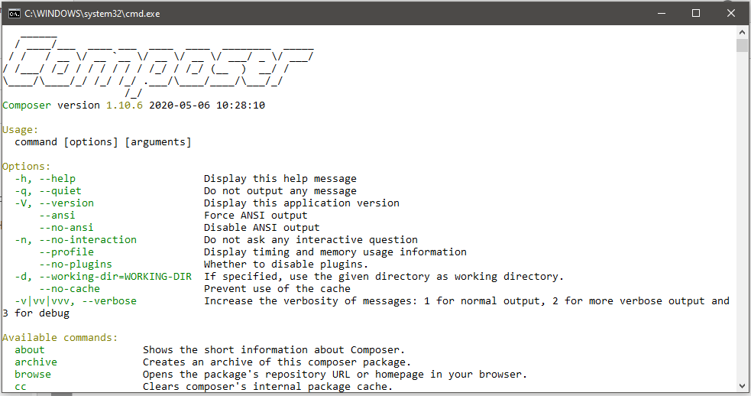
Installing Laravel
Install Composer (Cont)
Fig 3. Composer ready to use

Slide 18
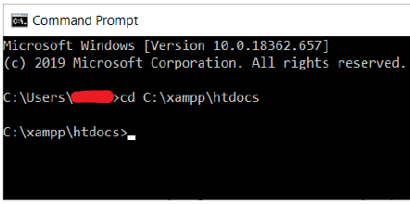
Installing Laravel
Install Laravel with Composer Create-Project
Please open cmd and then move to the XAMPP htdocs folder with the command cd C:\xampp\htdocs.
Then type or copy the following command:
Fig 4. Move to Folder XAMPP/htdocs
composer create-project --prefer-dist laravel/laravel coba1

Slide 19
Installing Laravel
Install Laravel with Composer Create-Project (Cont)
The command consists of several parts:
composer: run composer
create-project: create a project
--prefer-dist laravel/laravel: select the latest stable version of laravel framework
coba1: save all files into coba1 folder
After typing composer create-project command, then when we press Enter key, composer will work and download all Laravel files. This process takes a few minutes because the Laravel file size is quite large (about 40MB).

Slide 20
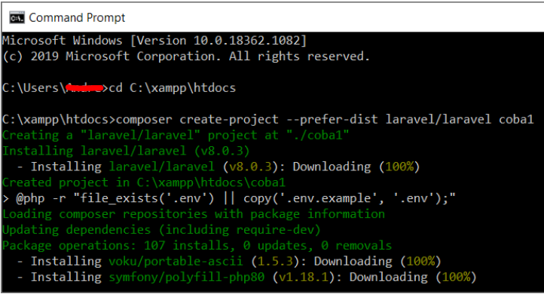
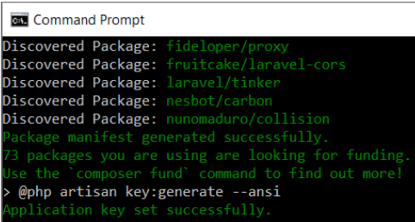
Installing Laravel
Install Laravel with Composer Create-Project (Cont)
Fig 5. Process Installing Laravel(Above) & Complete Installation (Below)

Slide 21
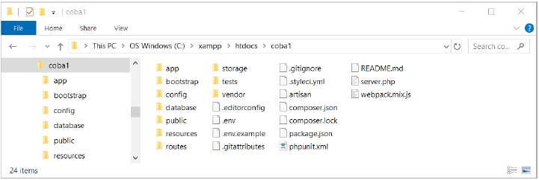
Installing Laravel
Install Laravel with Composer Create-Project (Cont)
If the text 'Application key set successfully' appears and the cursor returns to C:\xampp\htdocs, it means that the Laravel installation process is complete. Please open the htdocs folder from Windows Explorer, you will see a coba1 folder containing various Laravel files.
Fig 6. the contents of the coba1 folder

Slide 22
Installing Laravel
Installation based on Laravel version
Type the command below. The number 8.0 indicates the Laravel version you want to install. Please adjust the Laravel version.
composer create-project --prefer-dist laravel/laravel="^8.0" coba3

Slide 23
Accessing Laravel
To run this default PHP server, we must use cmd. Please open cmd then go to the Laravel installation folder. Because the Laravel file I'm using is in C:\xampp\htdocs\laravel01, the command to change directories is:
Once inside the Laravel folder, start the web server with the following command:
Then end with the Enter key.
cd C:\xampp\htdocs\laravel01
php artisan serve

Slide 24
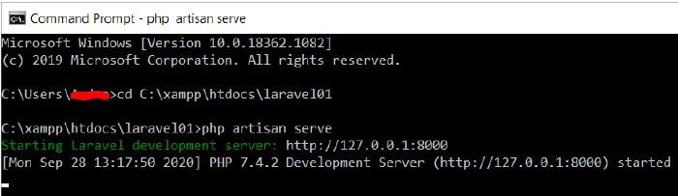
Accessing Laravel
If the server is active and can be accessed from http://127.0.0.1:8000. Please open a web browser and type this address.
Fig 7. Running Laravel Server

Slide 25
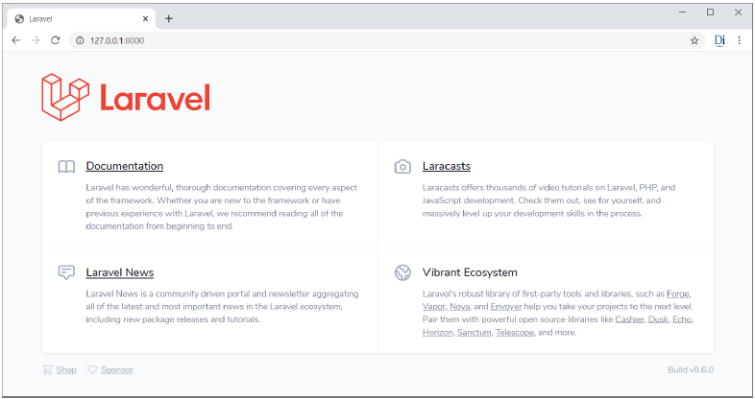
Accessing Laravel
Fig 8. Homepage Laravel

Slide 26
References
Lukmanul Hakim. (2020). Konsep & implementasi Pemrograman LARAVEL 7 Edisi BEST PRACTICE. CV. LOKOMEDIA. Yogyakarta. ISBN: 978-602-6231-25. Chapter 1 & 3
Andre Pratama. (2019). Laravel Uncover. DuniaIlkom.
https://www.tutorialspoint.com/laravel/laravel_overview.htm
https://www.youtube.com/watch?v=lWQ0uozfWFA

Slide 27
Thank You

